Slide 1
A CASE OF UNDIAGNOSED ULCER
DR.T.AJAYAN
PROF. & H.O.D.
PM

Slide 2
Case summary
A 90 years old male named Mr.Appukuttan, who was a maison residing at ponmanai came to OPD with the complaints of ulcer on right cheek, presence of pus and slough, surrounding skin become pale, ulcer has no pain but mild pain radiate to right ear since 2weeks.

Slide 3
History of presenting complaints:
Patient had a history of a single black nodule on the right cheek since 10 years and 2weeks back suddenly that nodule removed it manually and formed an ulcer. He treated allopathic medicine but an ulcer gradually increasing and presence of maggots also, so the physician advised to biopsy, but that time patient was not able to do biopsy because of financial problem, so he came under homoeopathic treatment.

Slide 4
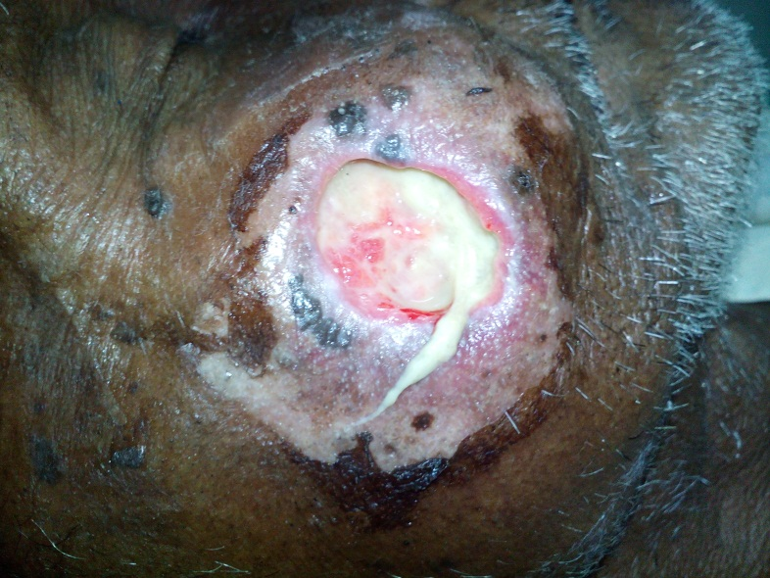

Slide 5
History of past illness:
Childhood-Jaundice traditionally treated
Before 6yrs done cataract surgery
No history of HTN,DM, Cardiac complaints
Family history
One of the sisters son died of cheek CA

Slide 6
Personal history:
Alcoholic and withdrawed 1year back
Physical features
Thin, Moderate, dark complexion, steady gait, unwell

Slide 7
Generals
Patients feels hunger at regular interval's , thirsty, good natural sleep, bowels regular, urine normal and normal perspiration
Reaction to
Aversion sweet, desire warm food, warm drinks, egg. desire for clothing and covering.

Slide 8
Physical examination
There is no evidence of pallor, lymphadenopathy, cyanosis, icteric, clubbing, pedal oedema.
Pulse is 66/min, regular, normal character and there is no radio femoral or radio radio delay no pulse deficit and peripheral pulses are palpable.
Respiratory rate 14/mins, abdomino thoracic type
B.P 120/80 mmHg
Weight 48.9 kg

Slide 9
ADMITTED
First prescription
Rx
Condurango 30 / 2 D
C&D Echinacea Q

Slide 10
02-06-2015
Radiating pain is persisting, feels fullness of right ear BP:110/80mmHg
Rx
Placebo
C&D Echinacea Q

Slide 11
03-06-2015
Radiating pain is persisting, feels fullness of right ear, heart burn, sleeplessness upto 2’O clock BP:110/80mmHg
Rx
Kali sulph 200/1 D
C&D Echinacea Q

Slide 12
04-06-2015
Radiating pain feels better, sleep good BP:120/80mmHg
Rx
Placebo
C&D Echinacea Q

Slide 13
05-06-2015
Radiating pain is feel better, sleeplessness BP:120/70mmHg
Rx
Kali sulph 200/1 D
C&D Echinacea Q

Slide 14
06-06-2015
Radiating pain is feel better (occ), sleep-Satisfied BP:130/80mmHg
Rx
Placebo
C&D Echinacea Q

Slide 15
07-06-2015
Radiating pain is feel better (occ), sleep-Satisfied BP:130/80mmHg
Rx
Placebo
C&D Echinacea Q

Slide 16
08-06-2015
No Radiating pain
BP:130/80mmHg
Burning micturition (occ)
Rx
Placebo
C&D Echinacea Q

Slide 17
09-06-2015
No Radiating pain
BP:130/80mmHg
Stool regular
Rx
Placebo
C&D Echinacea Q

Slide 18
10-06-2015
No Radiating pain
BP:128/68mmHg
Stool regular
Rx
Placebo
C&D Echinacea Q

Slide 19
11-06-2015
No Radiating pain
Heart burn
BP:130/72mmHg
General good
Rx
Placebo
C&D Echinacea Q

Slide 20
12-06-2015
No Radiating pain
Heart burn feels better
BP:130/70mmHg
Rx
Placebo
C&D Echinacea Q

Slide 21
13-06-2015
No Radiating pain
BP:130/72mmHg
Constipation for 2days
Rx
Placebo
C&D Echinacea Q

Slide 22
14-06-2015
No Radiating pain
BP:126/74mmHg
Stool regular
Rx
Placebo
C&D Echinacea Q

Slide 23
15-06-2015
BP:130/74mmHg
Stool regular
Rx
Placebo
C&D Echinacea Q

Slide 24
16-06-2015
BP:130/78mmHg
Stool regular
Rx
Placebo
C&D Echinacea Q

Slide 25
17-06-2015
BP:120/80mmHg
Generals good
Rx
Placebo
C&D Echinacea Q
DISCHARGED WITH PLACEBO

